Slide 1
Cloud and DevOPs
Project
Extraction, Transform and Load
Name: Nirmal Chhetri
Reg: 11916329

Slide 2
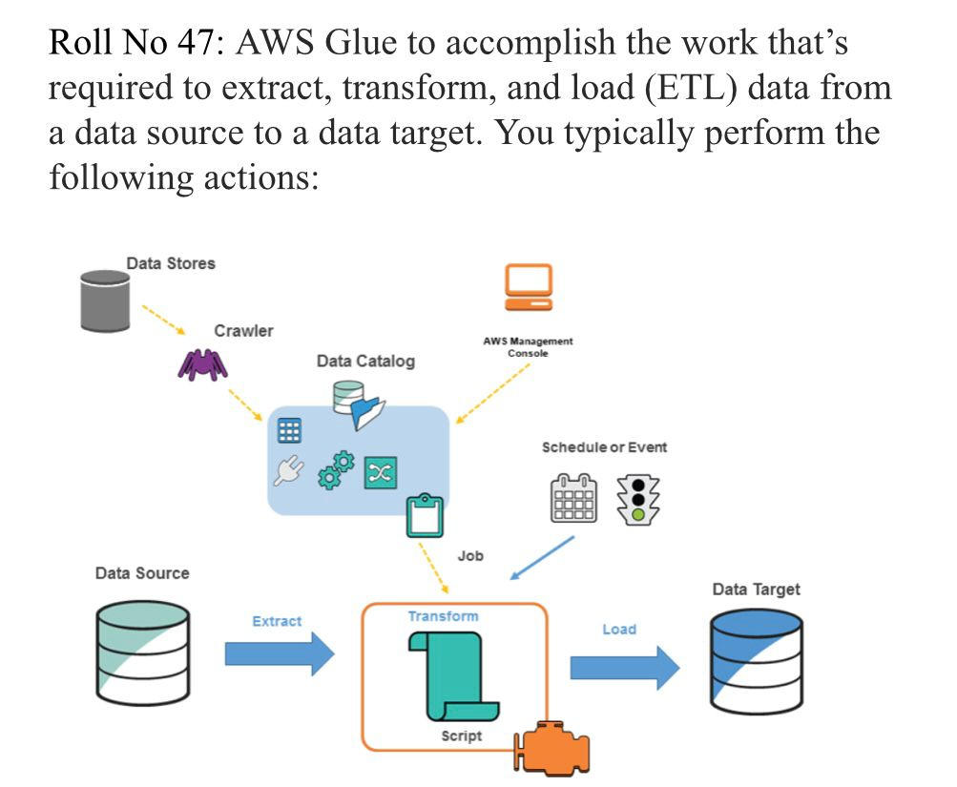

Slide 3
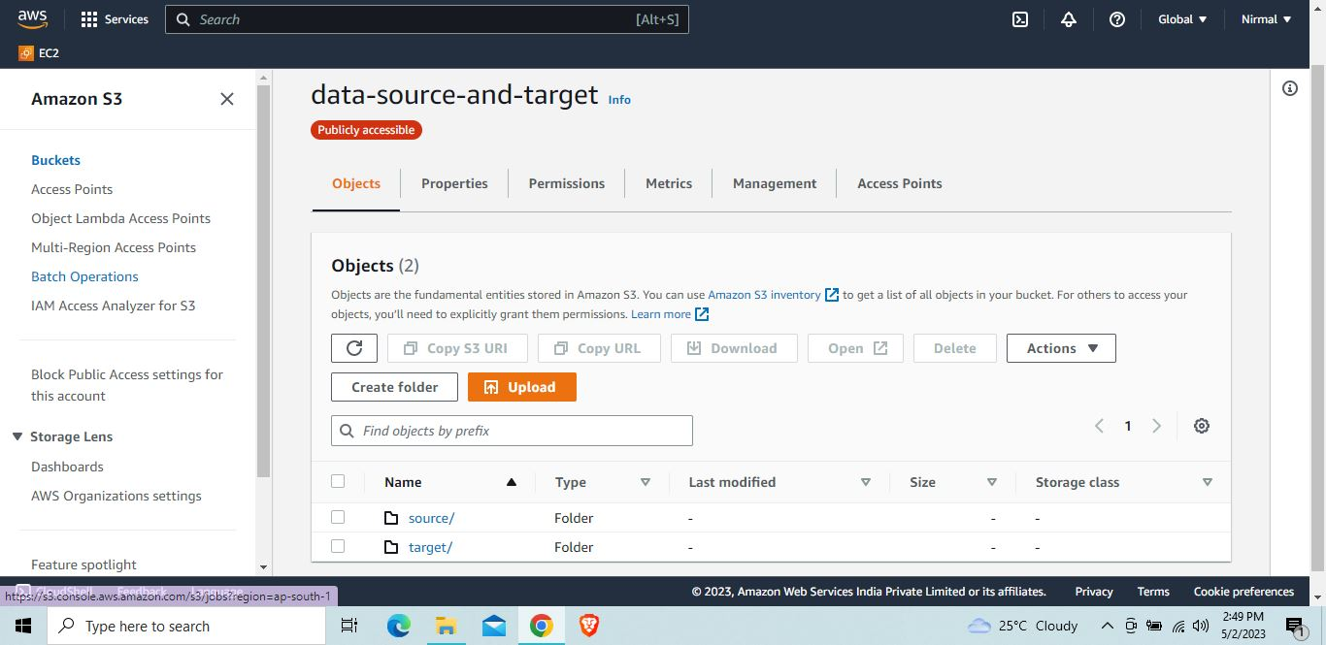
Created bucket called “data-source-and-target” and created two folders “source” and “target”

Slide 4
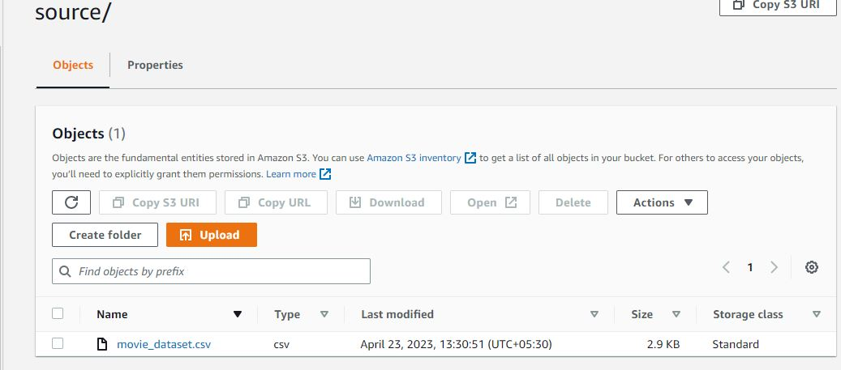
Inside folder “source” I upload my data named “movie_dataset.csv”

Slide 5
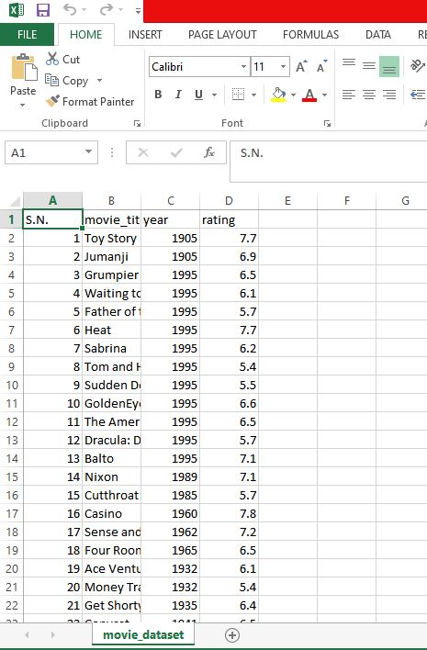
This is the dataset I want to process from s3 bucket

Slide 6
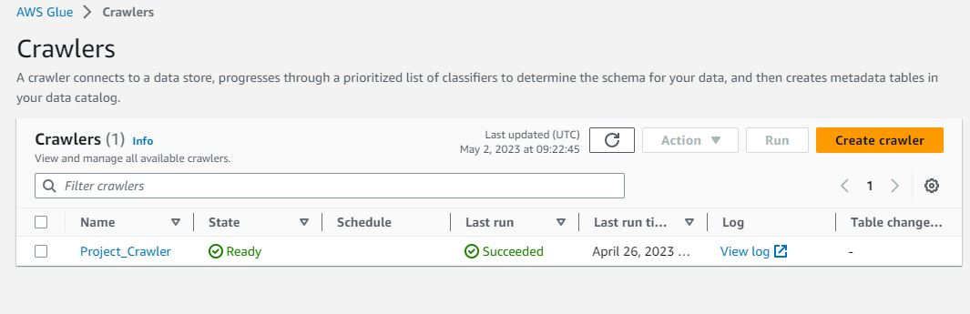
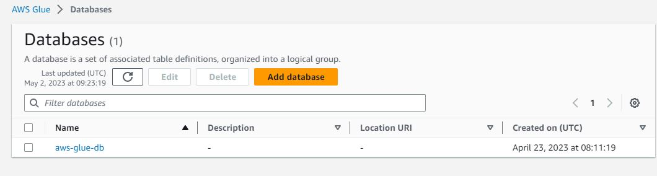
After s3, I moved to another service AWS-Glue and created “Project_ Crawler” and “aws-glue-db” database.

Slide 7
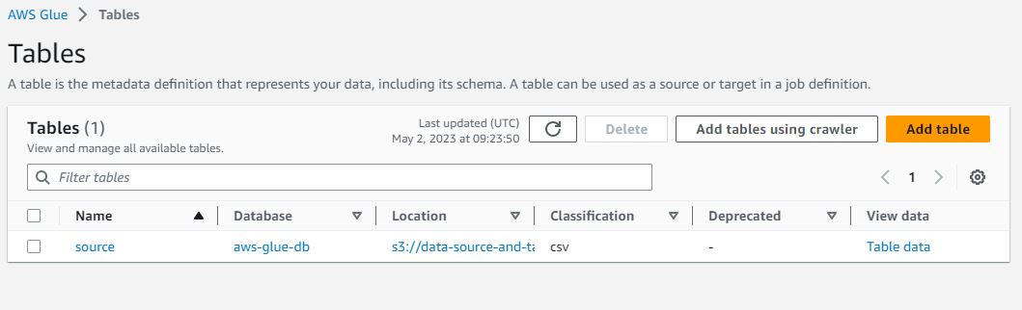
After creating database, I created tables to store the source data from s3 bucket.

Slide 8
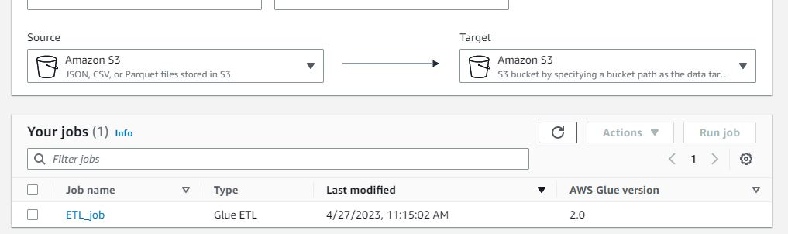
Created ETL jobs inside AWS-Glue service

Slide 9
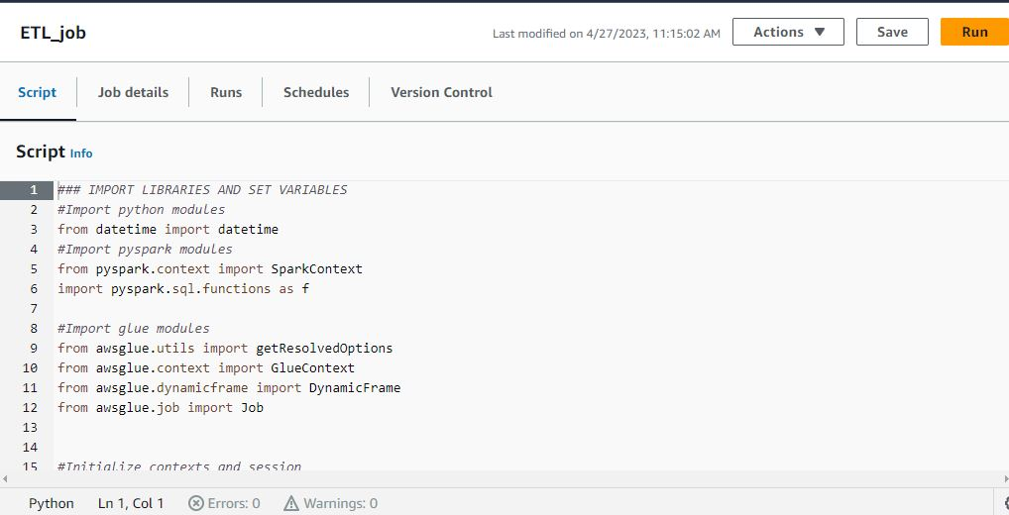
Script of etl job that extract data from s3 via tables. Logic behind the script is to convert the year of movies in
Decade and calculate average rating of movies of that particular decade.

Slide 10
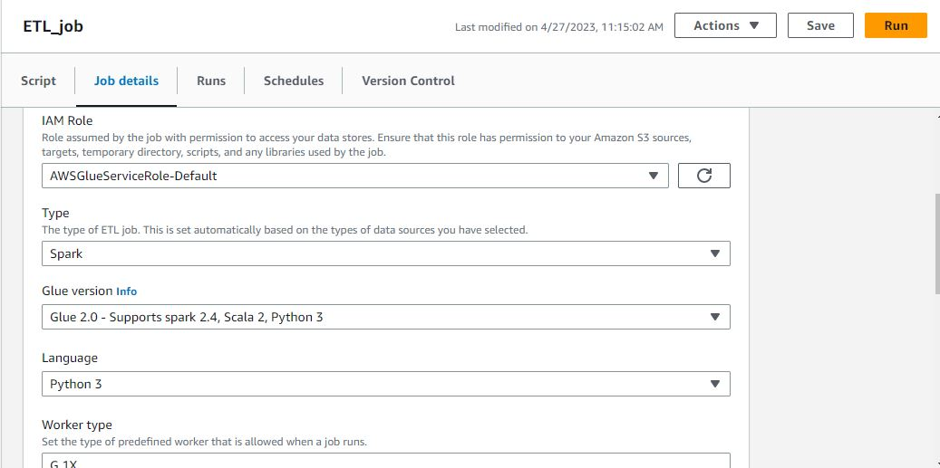

Slide 11
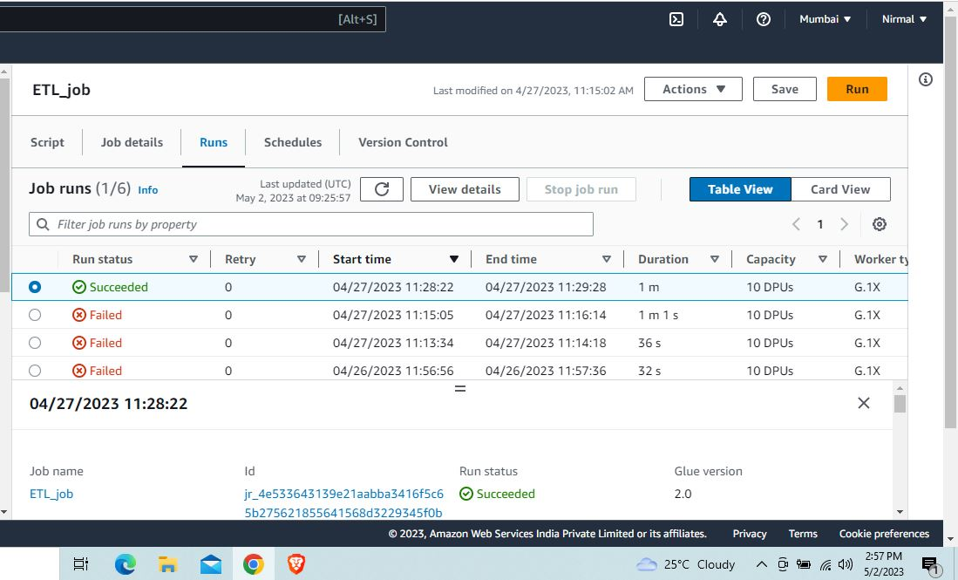

Slide 12
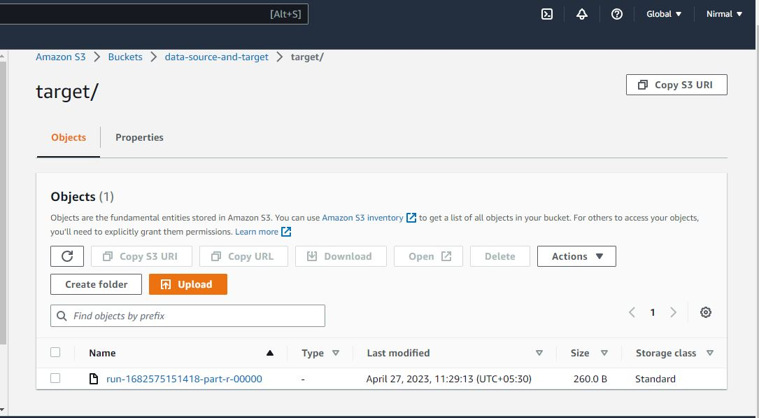

Slide 13
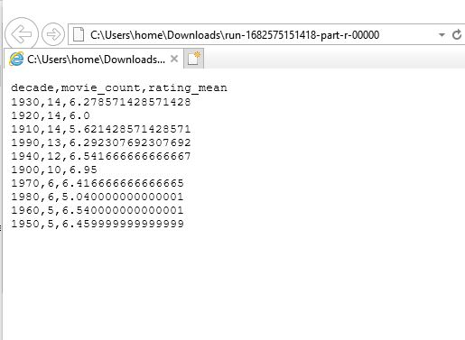
This is the output in the target folder of s3 buckets in which we can see all the years are
Converted into their particular decade and average rating of the movies in that particular
Decade. From this data we came to know that 1900’s decade has highest rating.

